Slide 1

21AIE114 PMS
FINAL TERM PROJECT

Slide 2





PRESENTED BY (BATCH B) TEAM - 19
Team
Mates
A
B
C
D
DHANUSH SANAPALA
CHINTA SUBHA SRIKAR
GALI ANAND RAJ
SUDIKSHA KUMARI
CB.EN.U4AIE21109
CB.EN.U4AIE21107
CB.EN.U4AIE21111
CB.EN.U4AIE21168

Slide 3
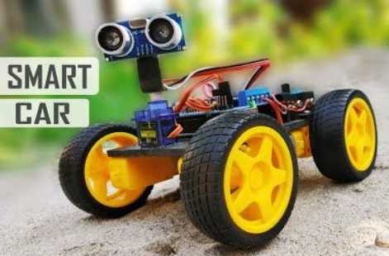
Project Topic
BLUETOOTH / VOICE CONTROL
OBSTACLE AVOIDING ROBOT
WITH AURDINO

Slide 4
ABSTRACT
The main aim of the robot is to scan the voice input or joystick input and process it for required operation and to do different tasks over specified area by controlling the robotic vehicle via voice command. The voice control technique consists of an Android app which communicates with the robot via Bluetooth module. Additionally, the robot will also have the proficiency to detect the obstacle, stops and avoid the obstacle by choosing different path with the help of Ultrasonic sensor.

Slide 5
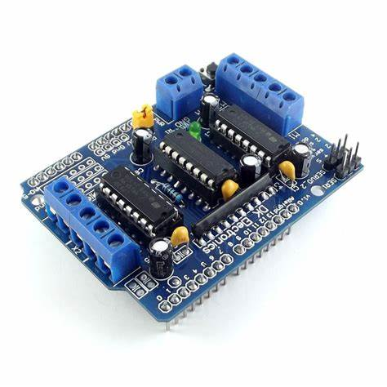
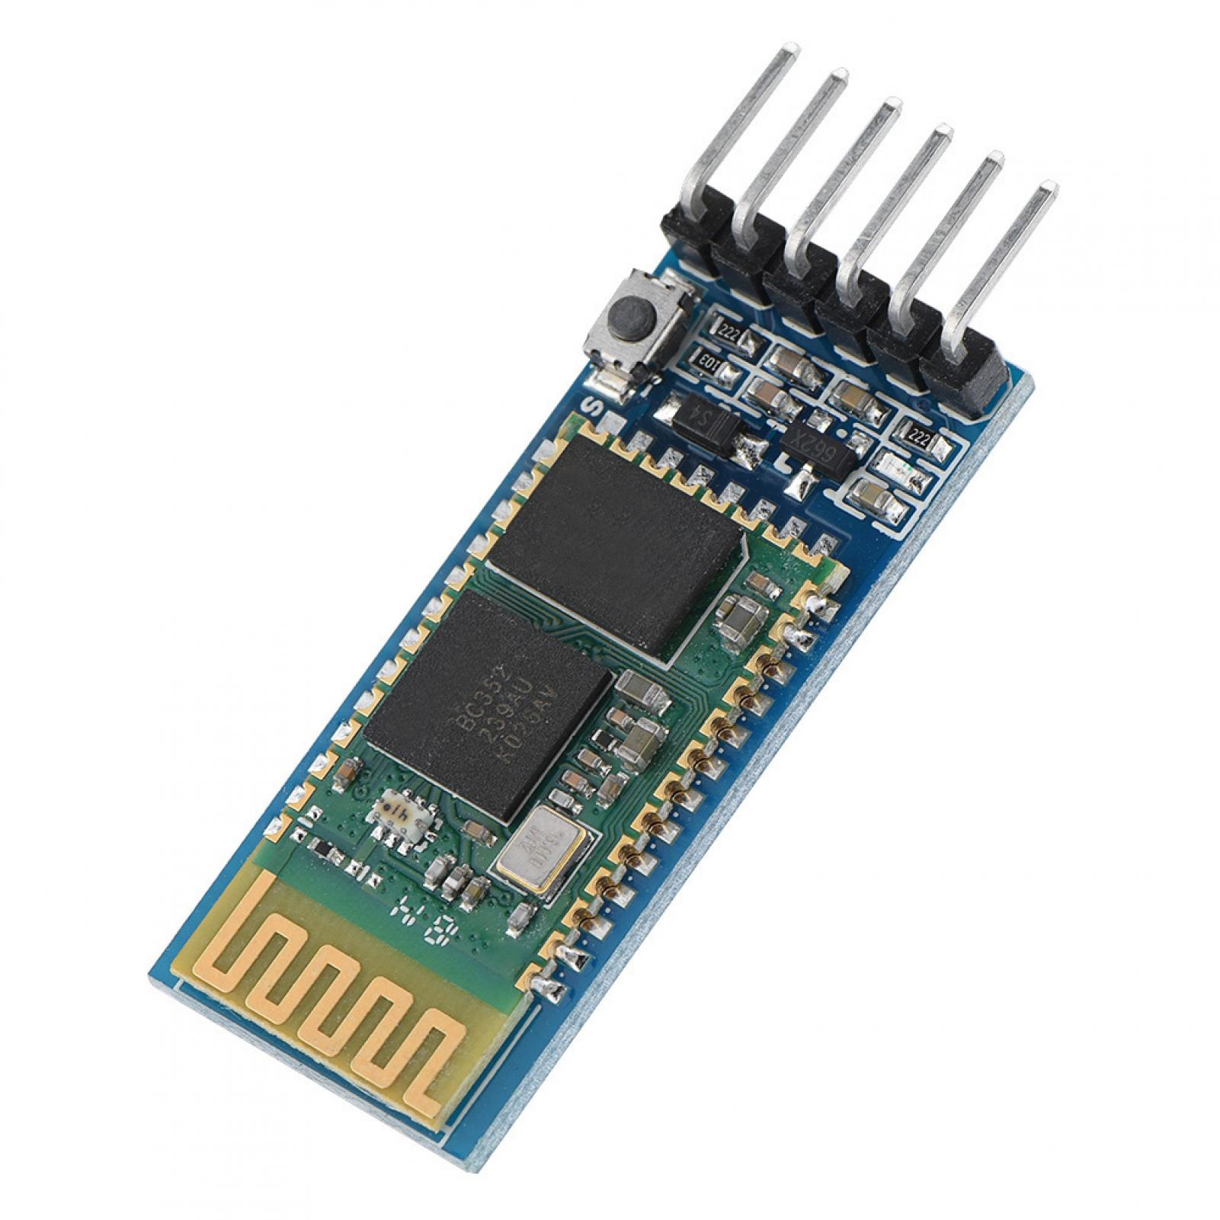
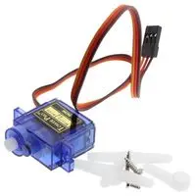
Materials Required {main}: ​
Arduino UNO ​
Ultrasonic Sensor ​
L293d Motor Driver Shield ​
HC-05 Bluetooth module ​
Servo motor ​
Foam board ​
IR sensor ​
BO motor and wheels, etc... ​

Slide 6

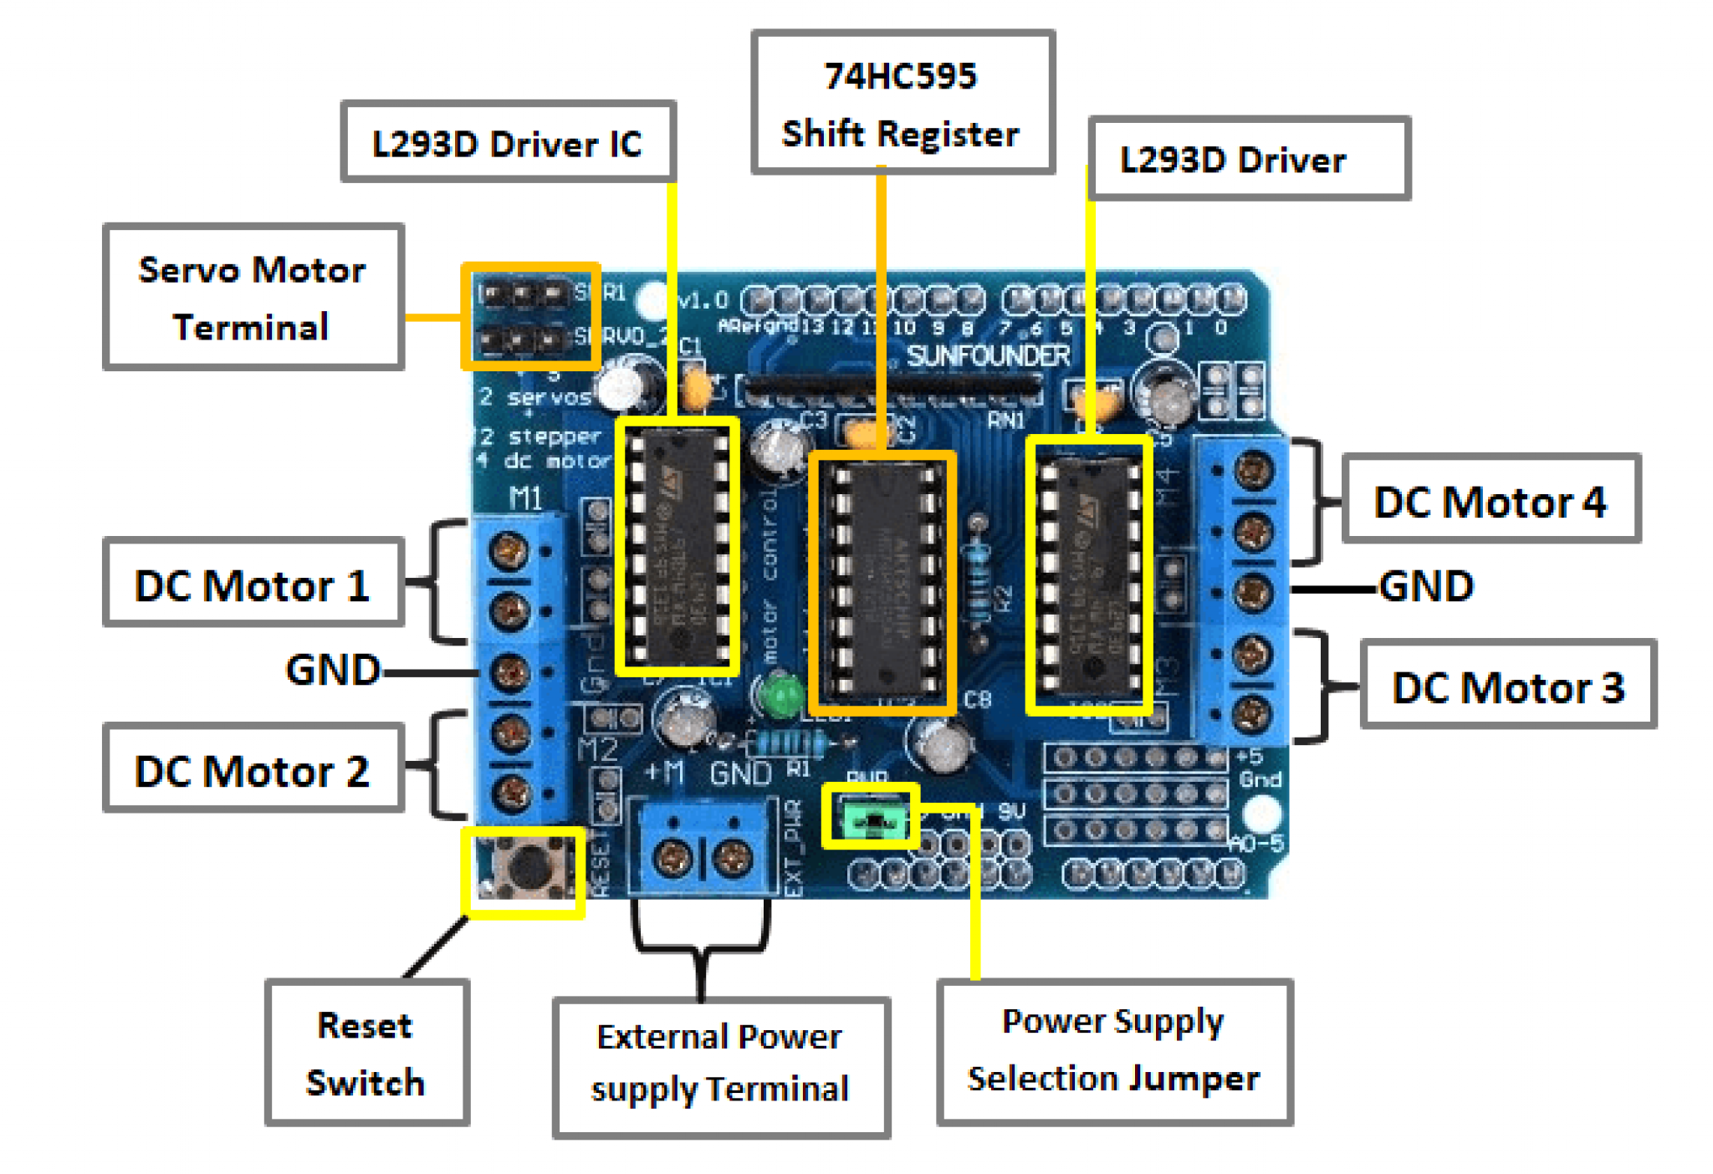
Now lets learn about individual components
Motor Driver Shield
L293D is a Motor driver IC used to control motors with a microcontroller. This motor shield consists of three IC’s. We can control 4 motors with the shield so there are two L293d Ic’s used. The motor shield is used for (Arduino Uno) board. This shield can control servo’s, Dc motors and stepper motors.

Slide 7
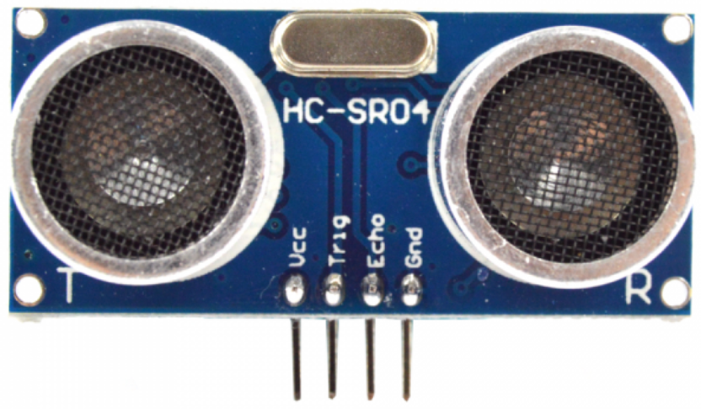
Now lets learn about individual components
Ultrasonic Sensor
Ultrasonic sensor is used to sense the obstacles in the path by calculating the distance between the robot and the obstacle. If a robot finds any obstacle it changes its direction and continues moving.

Slide 8
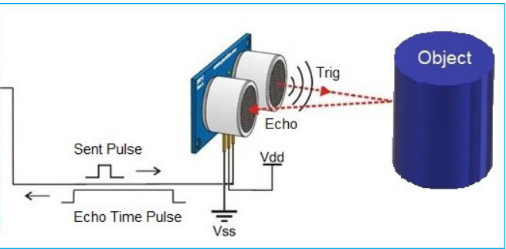
How to build obstacle avoiding robot using Ultrasonic Sensor?
Idea inside ultrasonic sensor
The basic principle behind the working of ultrasonic sensor is to note down the time taken by sensor to transmit ultrasonic beams and receive the ultrasonic beams after hitting the surface. The signal then hits the surface and returns back and captured by the receiver Echo pin of HC-SR04. The Echo pin had already made high at the time sending high.

Slide 9

How it works
Servo Motor
A servo motor is a rotary actuator that allows for precise control of angular position. It consists of a motor coupled to a sensor for position feedback. It also requires a servo drive to complete the system. The drive uses the feedback sensor to precisely control the rotary position of the motor.

Slide 10
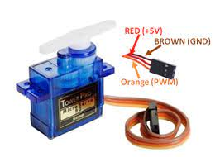
Wire configuration
Brown: Ground wire connected to the ground of system.
Red: Powers the motor typically +5V is used.
Orange: PWM signal is given in through this wire to drive the motor.

Slide 11
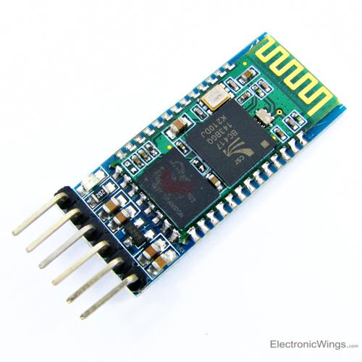
HC-05 Bluetooth module
HC-05 is a Bluetooth module which is designed for wireless communication. It has range up to <100m which depends upon transmitter and receiver, atmosphere, geographic & urban conditions. It uses serial communication to communicate with devices. It communicates with microcontroller using serial port.

Slide 12
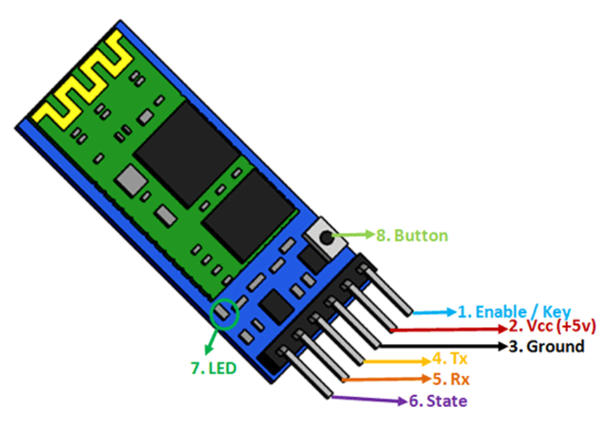
Pin configuration
Enable/key: This pin is used to toggle between Data Mode (set low) and AT command mode (set high).
Vcc: Powers the module. Connect to +5V or +3.3V Supply voltage.
GND: Ground Pin of module.
TXD: Transmit Serial data.
RXD: Receive data serially.
State: The state pin is connected to on board LED, it can be used as feedback to check if Bluetooth is working properly.
LED: Indicates the status of Module
Button: The command and data mode states are changeable through a button present on the module.

Slide 13
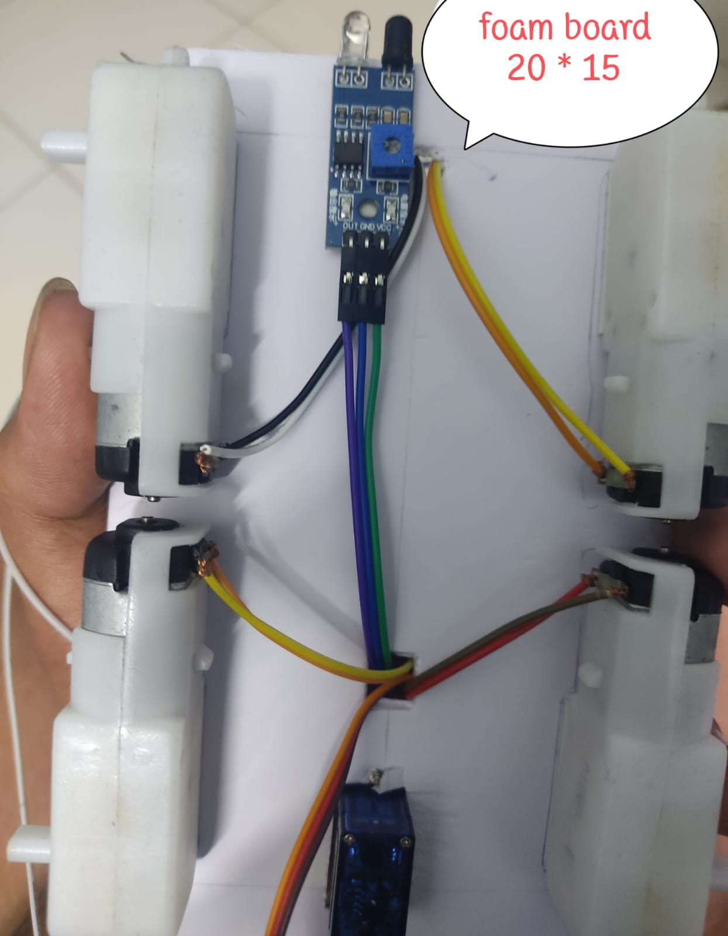
Procedure:[making]
Cut a foam board of length 20 cm and width 15 cm
Attach 4 stepper motor's and IR sensor to the back of the foam board
Now attach Arduino and clip the motor driver shield to the top of foam board

Slide 14
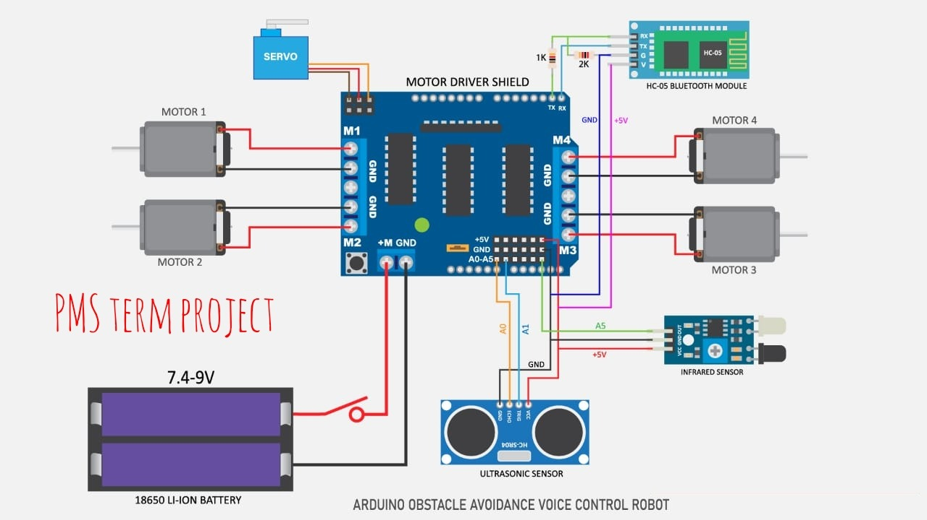
Circuit diagram
Apart from this circuit we have added
1 extra led and one extra buzzer+led at pin’s 12 and 13 respectively

Slide 15
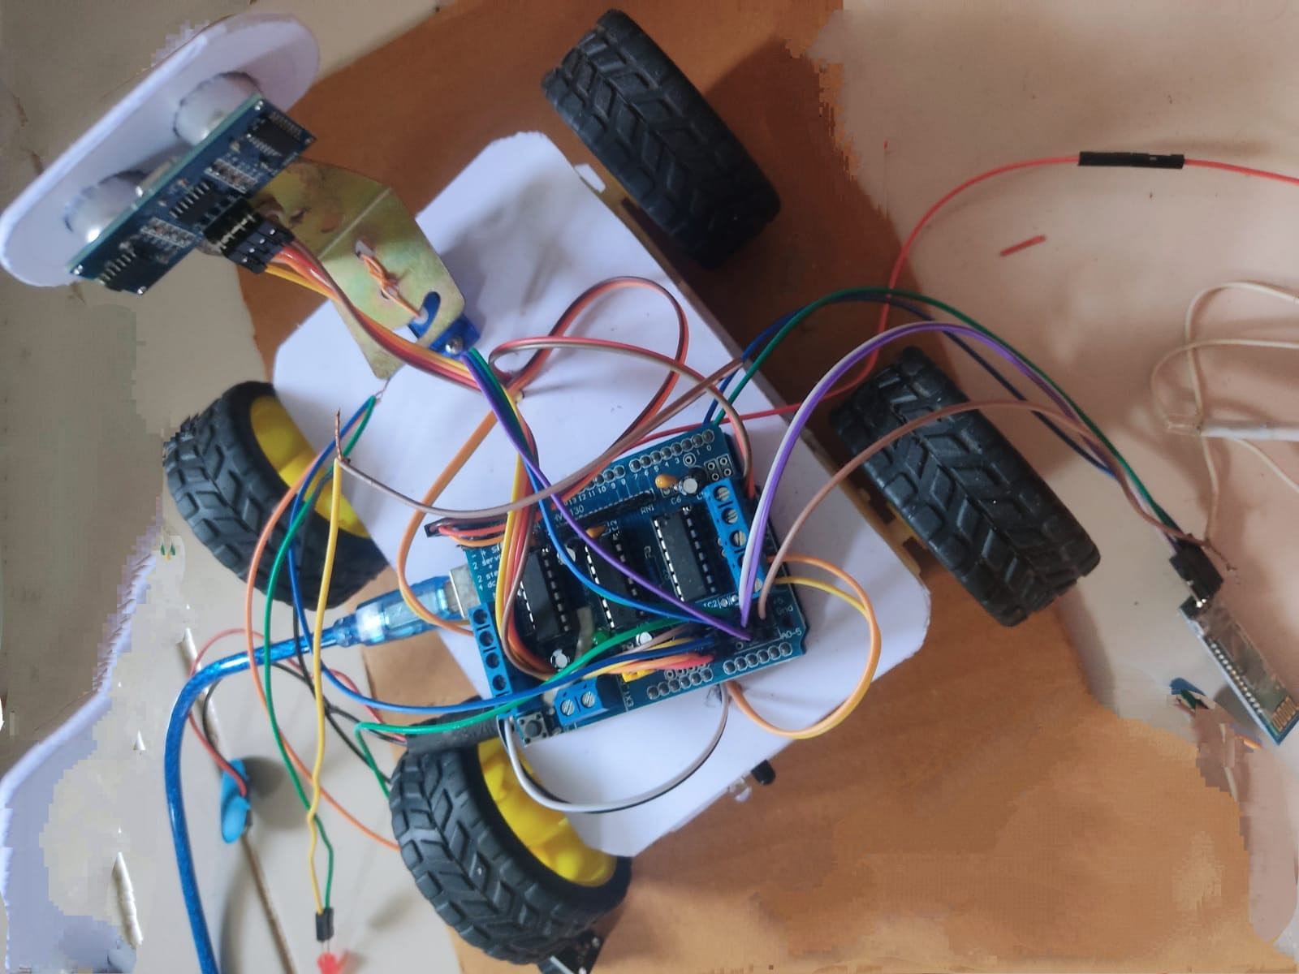
After attaching all the components as in the circuit diagram
Creating a holder for ultrasonic sensor to attach on servo motor using a foam board and a metal piece

Slide 16
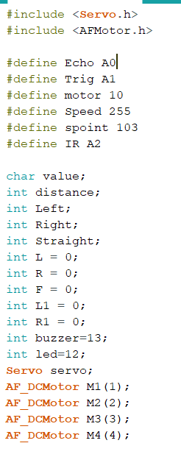
Code(sketch)
Variable declaration
&
Defining pins

Slide 17
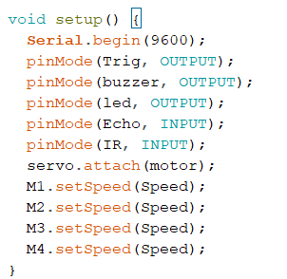
Code(sketch)
Void setup

Slide 18
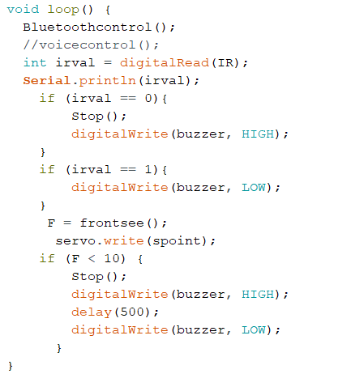
Code(sketch)
Void loop

Slide 19
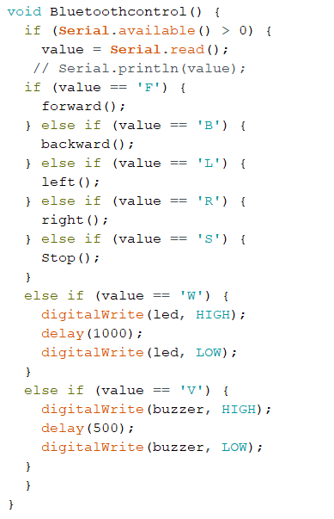
Code(sketch)
Void Bluetooth control

Slide 20
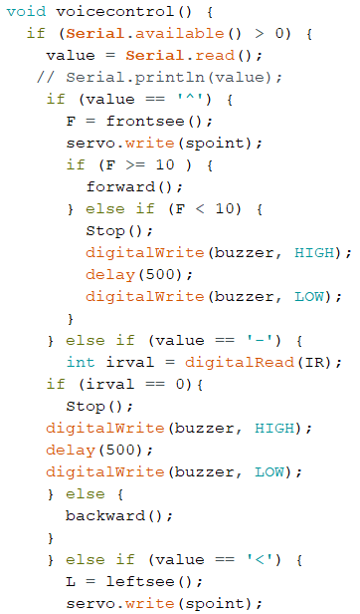
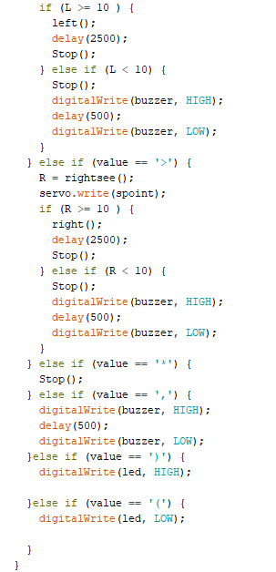
Code(sketch)
Void Voice control

Slide 21
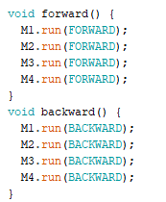
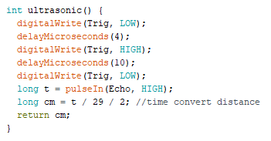
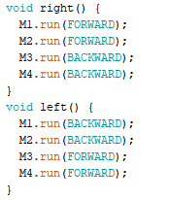
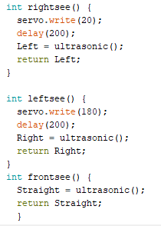
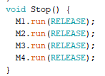
Different functions:
Void
functions
Functions with return

Slide 22
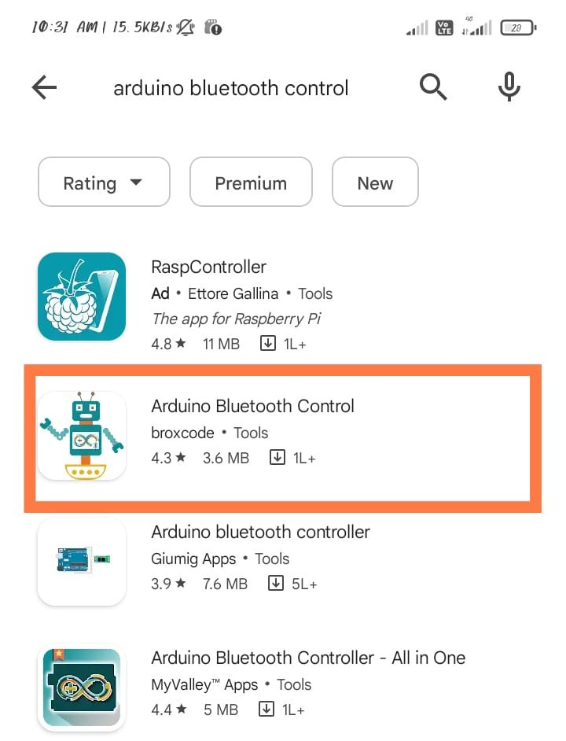
Bluetooth Voice Control mobile app
Download the particular app
Named Arduino Bluetooth Control from play store

Slide 23
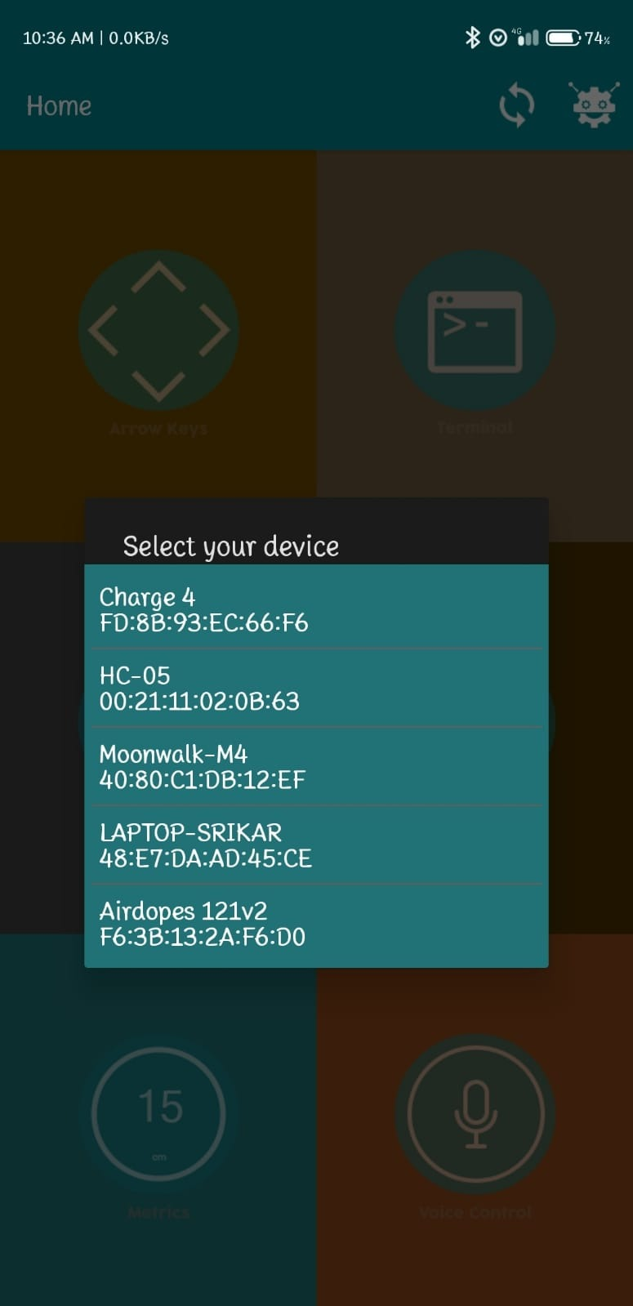
Connecting the Bluetooth module with mobile app
Connect to HC-05 which is the name of our Bluetooth module whose password will be 1234

Slide 24
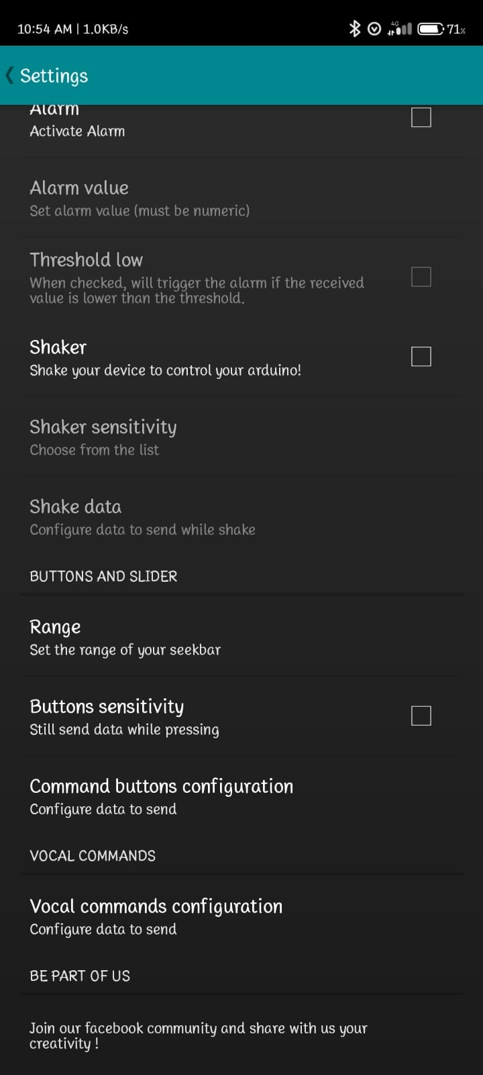
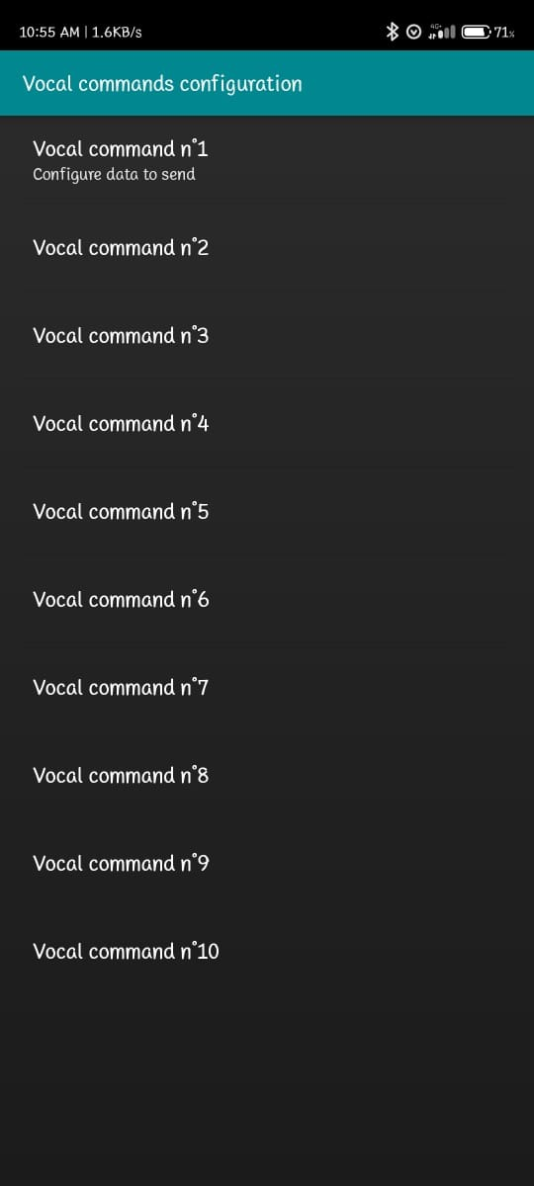
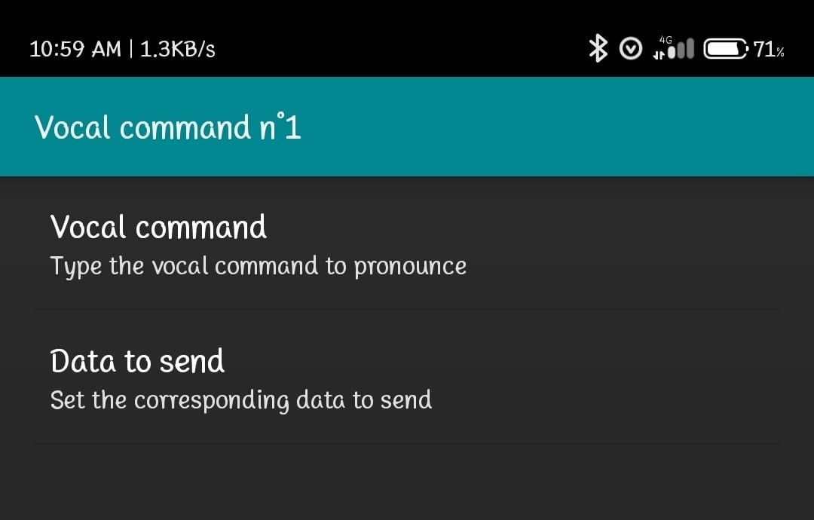
Setting Bluetooth commands to send
7 voice commands and their info to send

Slide 25




Commands and their decoding Char
Front = ‘^’
Back = ‘-’
1st
2nd
Left = ‘<‘
Right = ‘>’
3rd
Stop = ‘*’
Horn = ‘,’
Light = ‘)’
Dim = ‘(‘
4th

Slide 26
Applications
Basic applications of robots utilizing voice recognition are to support people with disability, executing present commands etc.
In agriculture for farming purposes by connecting the appropriate instruments to it. The robot can move right based on our commands, allowing us to perform some agricultural tasks entirely from a computer.
On board digital assistants for automobiles.

Slide 27
Surveillance applications to send live feed from camera and track down an object.
Important application in Industrial Robots where user can control the robotic vehicle via voice commands.
Indoor assistive robots which will navigate around to pick up objects from one place and place them at another using speech commands technique.

Slide 28
Future Scope
By attaching a bomb detector to the robot, we can use our personal computer to send it anywhere—to a battle field, a forest, a coal mine. The sensor can detect the bomb and send the information.
Instead of sending a human to a risky area and having them deal with difficulties there, we can send a robot there instead, and the sensor will identify the temperature, due to a temperature sensor connected to the robot.
We can obtain information about the concentration of gases or smoke by connecting a smoke sensor to the robot in coal mines, dangerous zones, etc.
It can be used for home security and military purposes where the commands can be given to robot without involving human risk by increasing the range and by installing cameras.

Slide 29
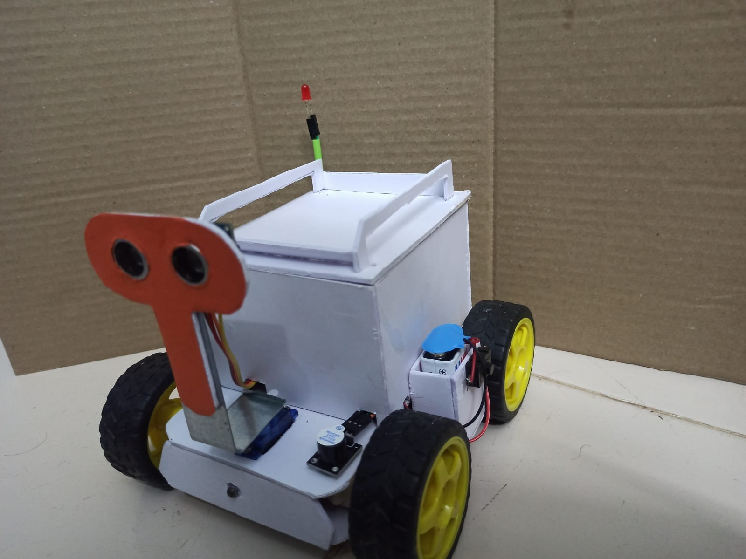
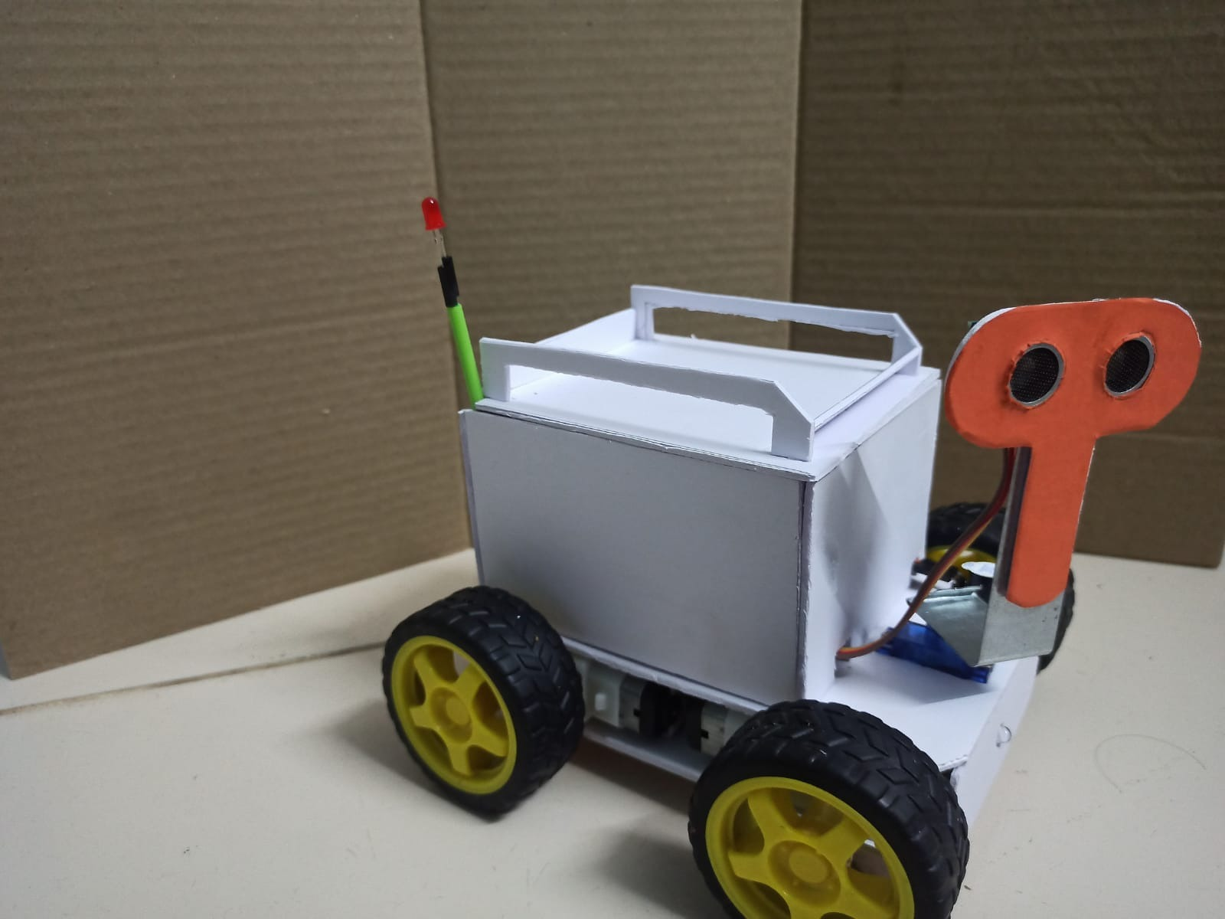
OUTPUT

